Slide 1

Makerspace Raspberry Pi
Workshop 3: Python on the Pi

Slide 2
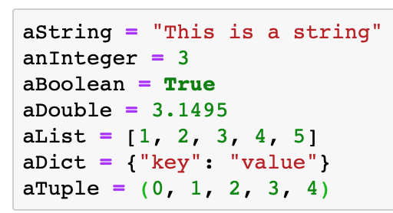
Variables in Python
Variables in python can take on the following types:
Integer
Double
Boolean
String
List
Dictionary
Object
Tuple
Assignment uses the equals sign

Slide 3

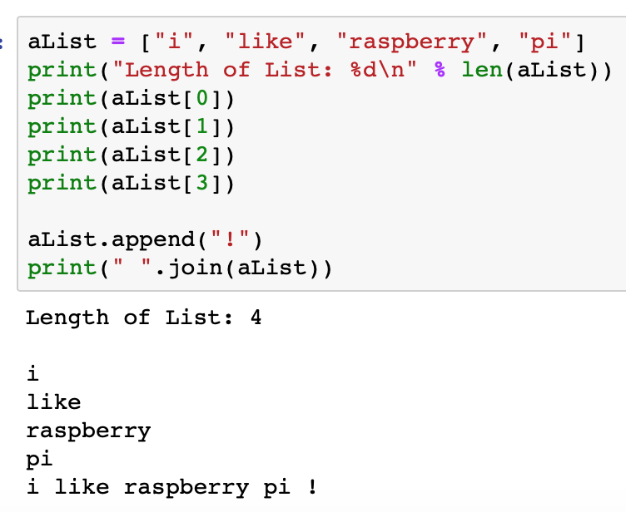
List
Elements can be accessed by their index starting from zero
Elements can easily be added or removed
Makes sense when you need to access a set of N things without needing to lookup a specific thing
A tuple is like a list that can’t be modified

Slide 4
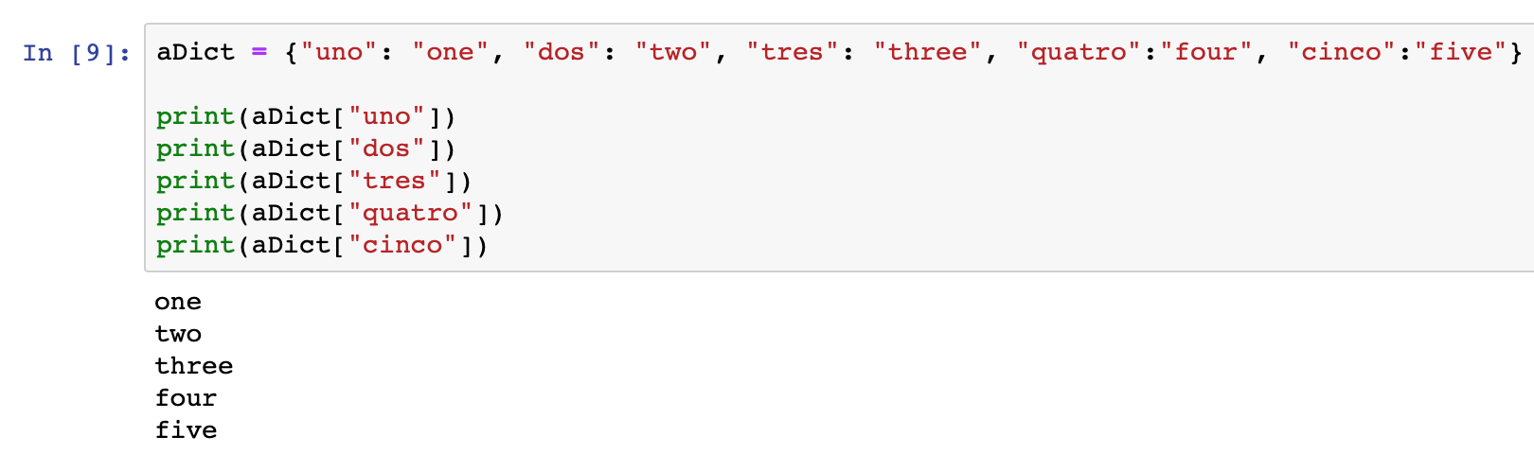
Dictionaries
Key value pair.
Lookup a word (key) in the dictionary, get its meaning (value)
Makes sense when you need to lookup specific things in a set

Slide 5
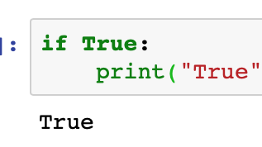
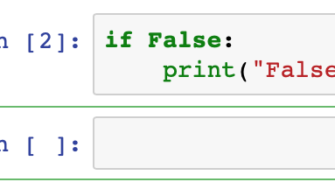
Conditionals
Fundamental building blocks of logic
If P, Then Q
We don’t write then in python, instead we use indentation to signal that we are in an if block

Slide 6
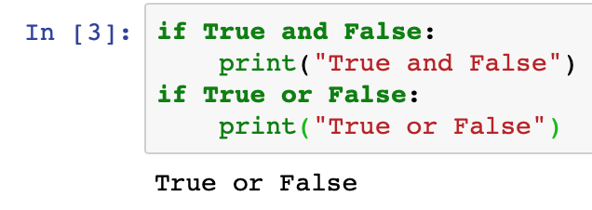
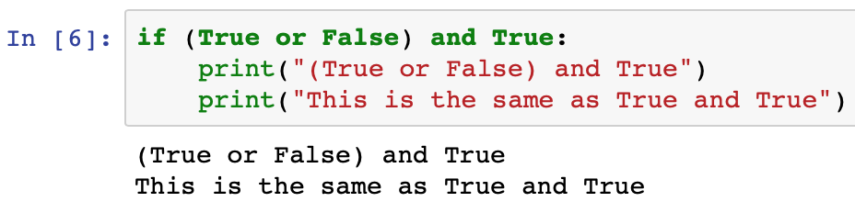
Joint Conditionals
Evaluated from left to right
Parenthesis can be used to create sub expressions that are all evaluated together

Slide 7
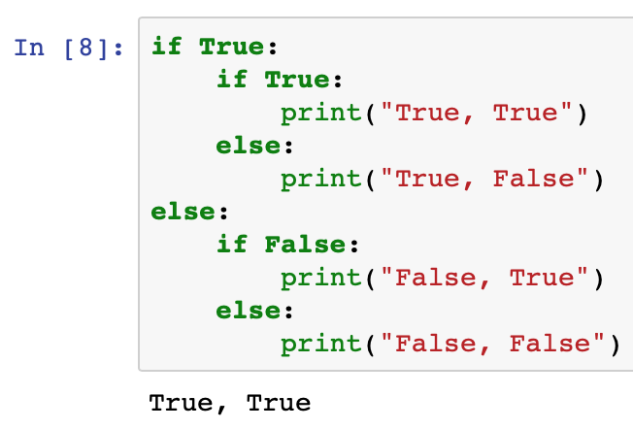
Nested Conditionals
A conditional within a conditional
Note: conditionals are not the only types of statements that can be nested

Slide 8
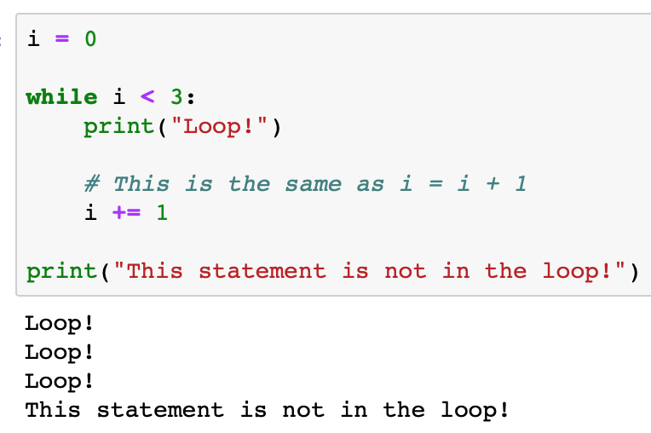
Loops
Do something over until a condition is met
Useful conditionals
A (If the expression A is true)
A == B (A is equal to B)
A < B (A is less than B)
A <= B (A is less than or equal to B)
A > B (A is greater than B)
A >= B (A is greater than or equal to B)

Slide 9
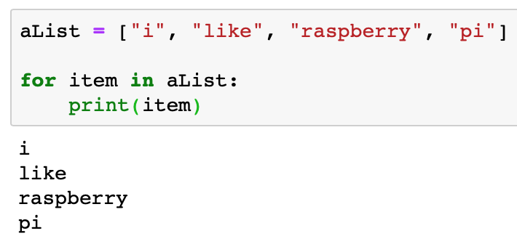
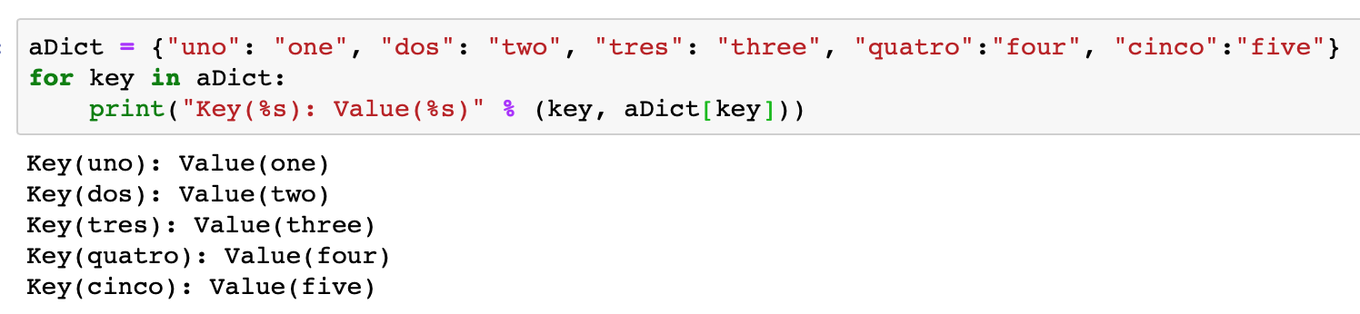
Looping over a set
Do something with each member of a set

Slide 10
Real World Example
python/lesson2_motion.py
Each loop reads a frame, processes it, and if motion is detected it is drawn on the screen
Exit condition for the loop is pressing the q key
Contains many nested statements, lets go through it line by line!

Slide 11
Assignment: Favorite Hobbies
Do the following on the Raspberry Pi using python:
Create a dictionary with your hobbies and containing a short description of each one
Loop through each hobby, and see if it is your “most favorite” hobby out of all of them
If it is, print the hobby with its description

